Slide 1


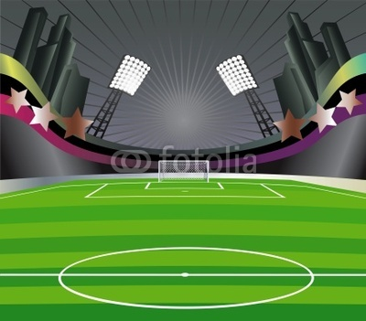


Slide 2
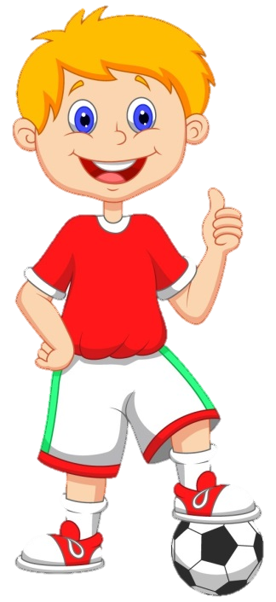
VOCABULARY
QUIZ

Slide 3

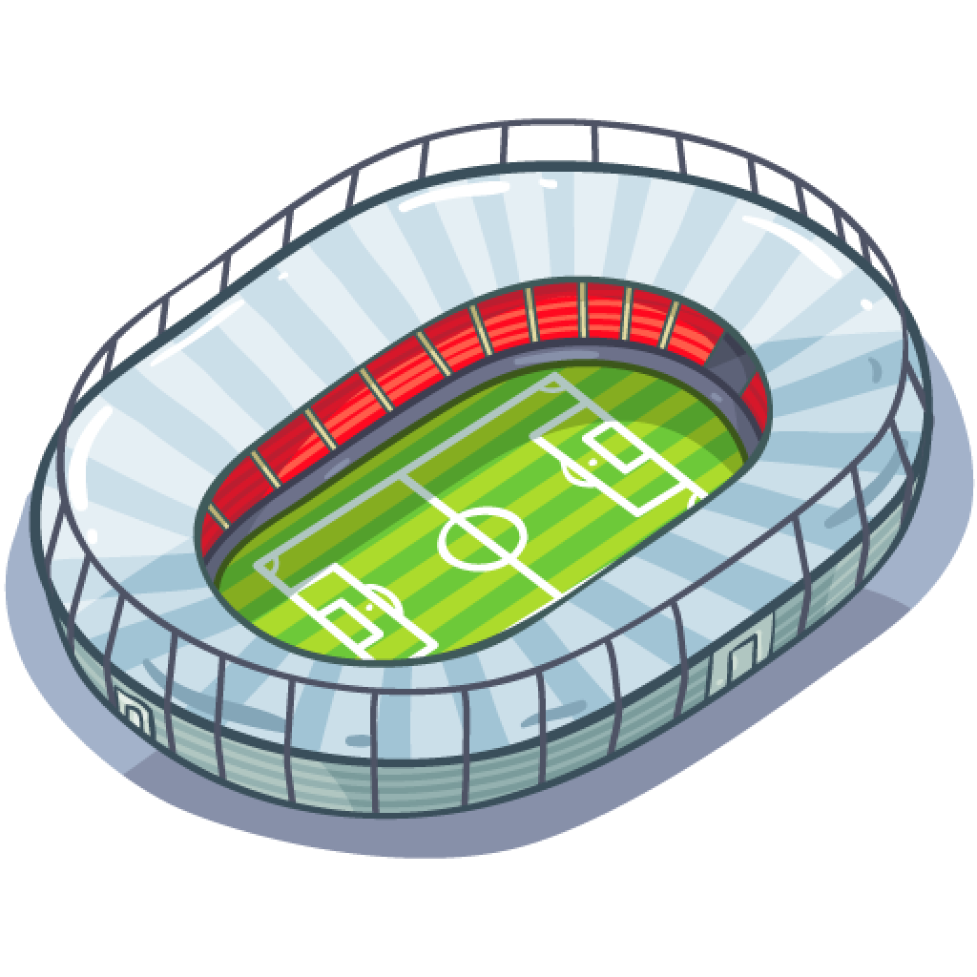
This is a STADIUM

Slide 4
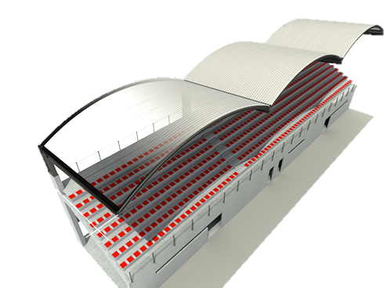
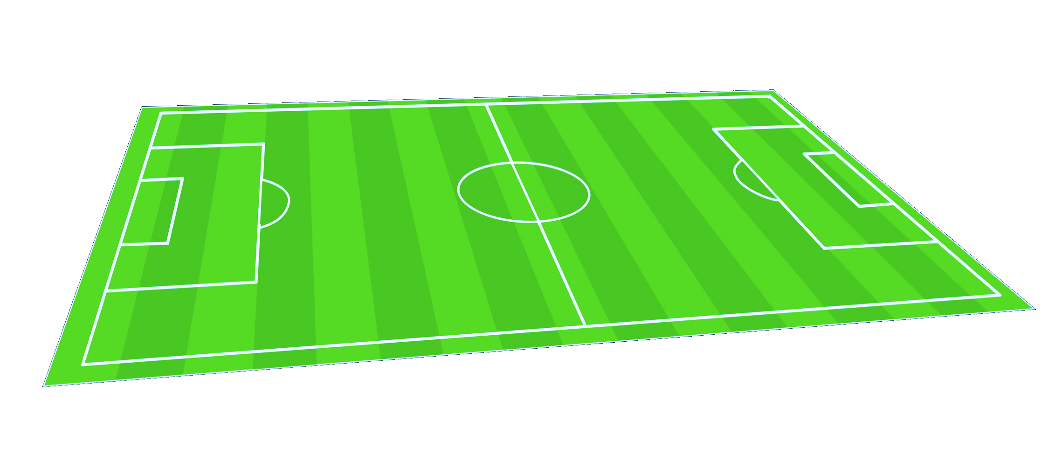
These are the BLEACHERS

Slide 5
This is the PITCH

Slide 6
This is the touch line
This is a
corner arc
This is the goal line
This is the
penalty area
This is the
centre circle
This is the
penalty spot
This is the
goal area
This is the
halfway line
This is a
corner flagpost

Slide 7
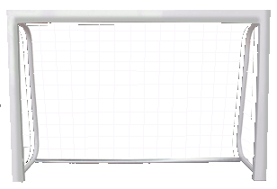
This is the GOAL
This is the CROSSBAR
This is a
GOALPOST
This is the NET

Slide 8

These are the FANS
RESPECT
NO TO RACISM

Slide 9
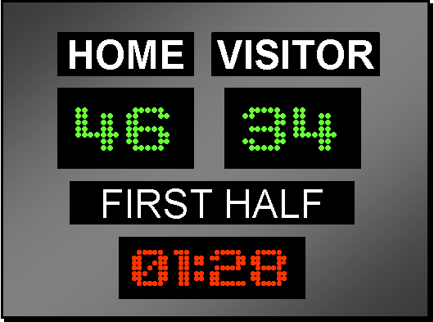
This is the SCOREBOARD

Slide 10
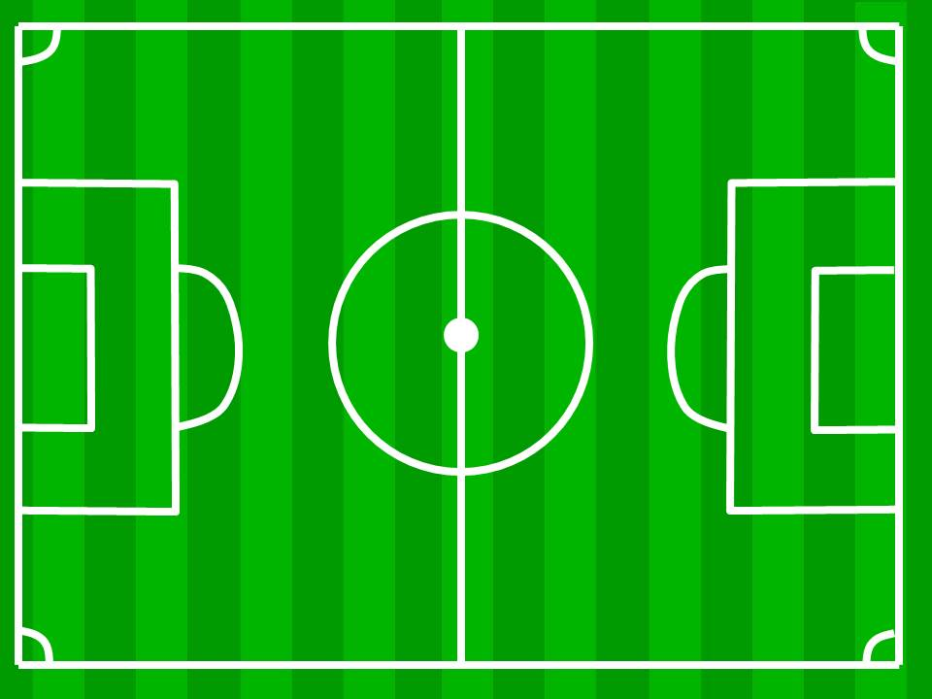
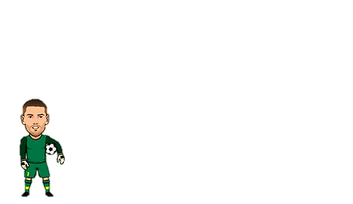


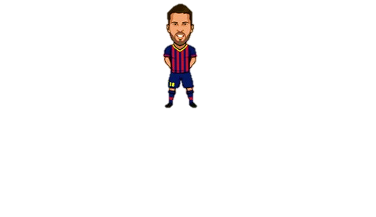
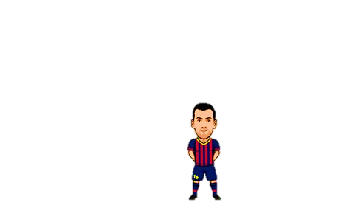
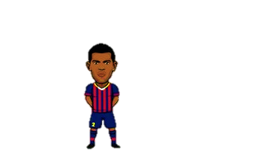
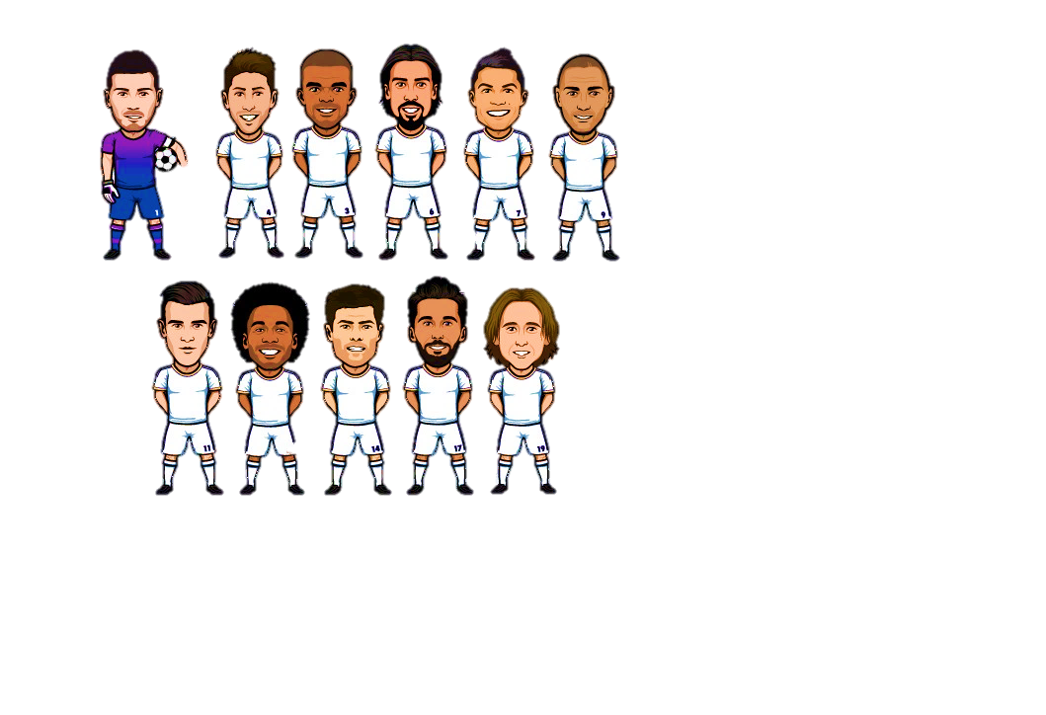



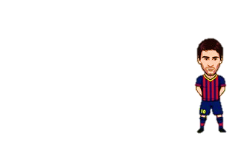

These are the TEAMS.
There are 11 PLAYERS in each team.

Slide 11
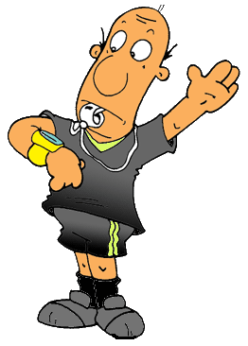


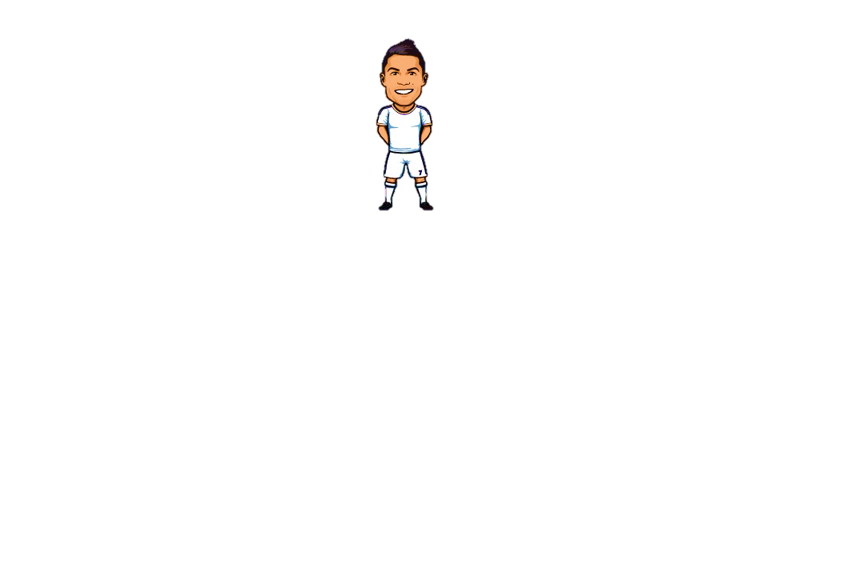
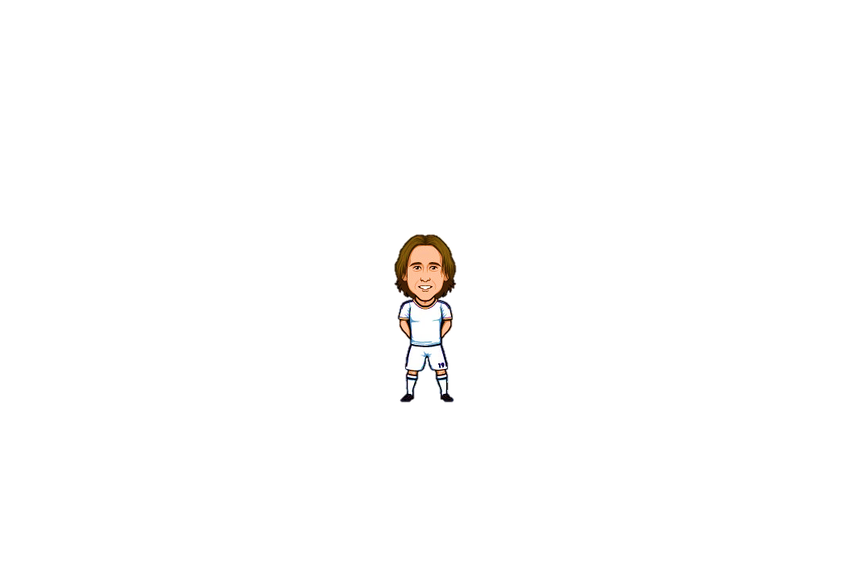
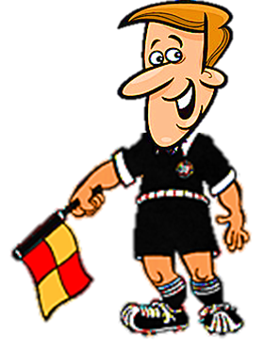
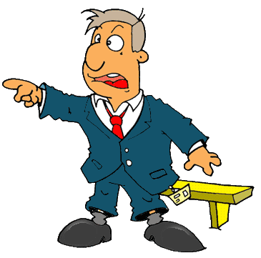
This is the
REFEREE
This is a
FORWARD
This is a
DEFENDER
This is a
MIDFIELDER
This is the
GOALKEEPER
This is a
LINESMAN
(assistant referee)
This is the
COACH

Slide 12
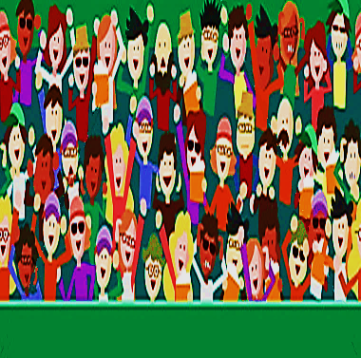
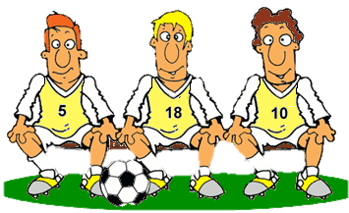
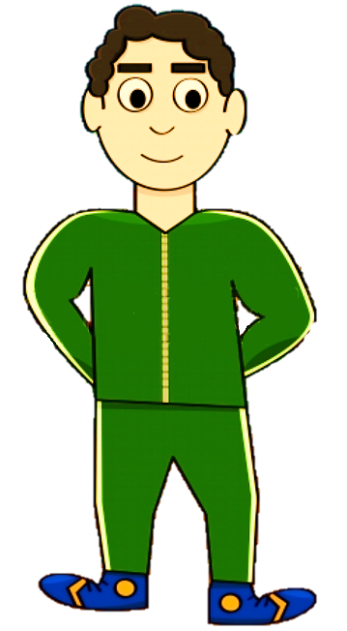




FAIR PLAY
NO TO RACISM
This is the
BENCH
These are the
SUBSTITUTES
This is the
MASSEUR

Slide 13
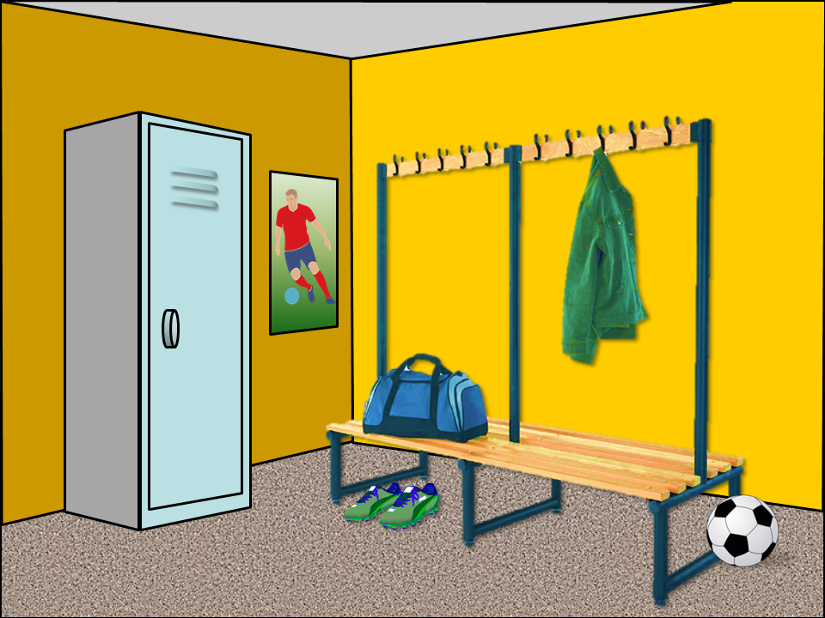
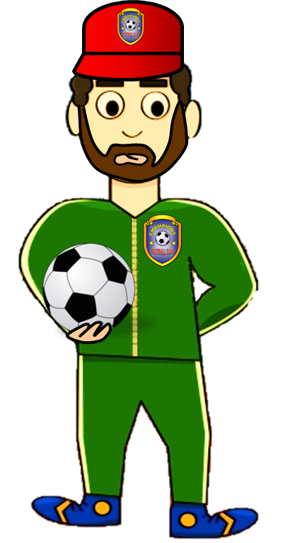
This is the CHANGING ROOM
This is the
KIT MAN
This is a
SPORTS BAG
This is a
BALL
This is a LOCKER

Slide 14

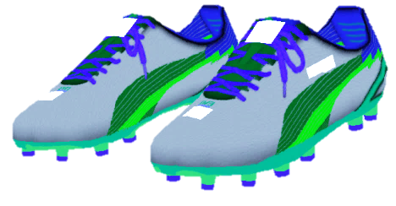
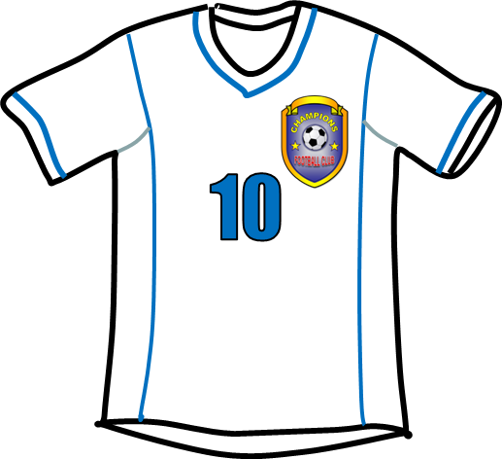

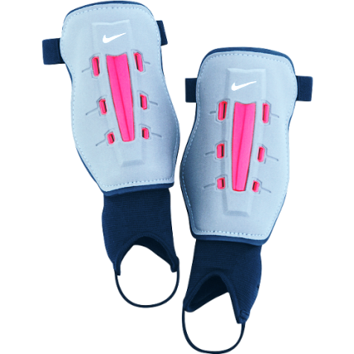
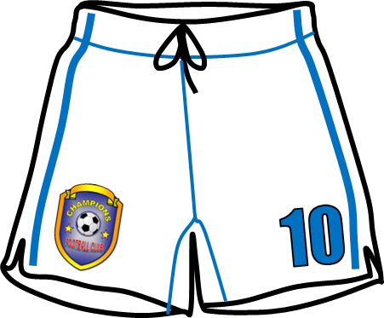
This is the EQUIPMENT
This is a SHIRT
These are BOOTS
These are SOCKS
These are SHIN PADS
This is an EMBLEM
These are SHORTS

Slide 15



This is a
YELLOW CARD
This is a
RED CARD
This is a
WHISTLE
This is a
FLAG

Slide 16
Do you like football?
Do you play it?
How often do you play football?
What’s your favourite team?
Describe the equipment of your team.
Who’s your favourite football player?
Why do you like him?

Slide 17

FOOTBALL
QUIZ

Slide 18

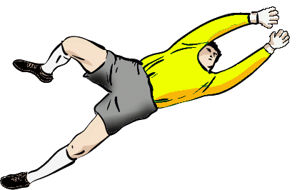
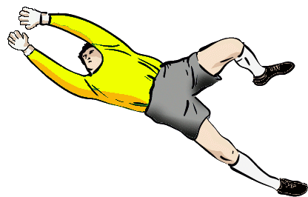
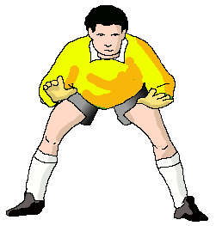
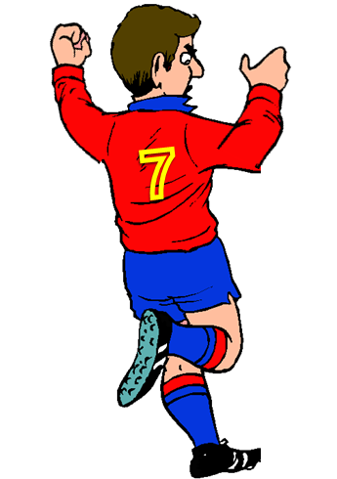
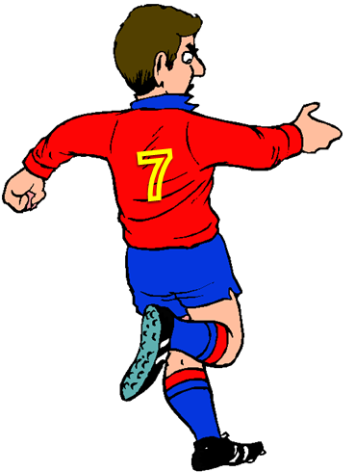
The linesman holds one of this.
FAIR PLAY
NO TO RACISM
NEXT
a whistle
a flag
a card

Slide 19
He develops the skills of individual players and helps teams to win
FAIR PLAY
NO TO RACISM
NEXT
the kit man
the masseur
the coach

Slide 20
He is allowed to touch the ball with his hands.
FAIR PLAY
NO TO RACISM
NEXT
the goalkeeper
the forward
the defender

Slide 21
You can see the result of the match on it.
FAIR PLAY
NO TO RACISM
NEXT
the goal
the scoreboard
the bench

Slide 22
The substitutes stay on it when they are not playing.
FAIR PLAY
NO TO RACISM
NEXT
the pitch
the goal
the bench

Slide 23
He raises the flag when the ball leaves the pitch
FAIR PLAY
NO TO RACISM
NEXT
the linesman
the coach
the referee

Slide 24
He blows a whistle to stop the game.
FAIR PLAY
NO TO RACISM
NEXT
the referee
the coach
the masseur

Slide 25
They play close to the goalkeeper of their own team.
FAIR PLAY
NO TO RACISM
NEXT
the midfielders
the forwards
the defenders

Slide 26
He takes care of the players health.
FAIR PLAY
NO TO RACISM
NEXT
the kit man
the masseur
the coach

Slide 27
They cheer the team on the bleachers.
FAIR PLAY
NO TO RACISM
EXIT
the players
the fans
the linesmen

